Slide 1

Project 3 – Stirred
(NOT shaken)
Malvin Varpe &
Torgrim Odde
Notes:
I will start, Malvin will cover the mid-section and I will wrap it up at the end.

Slide 2
Agenda
Introduction
Governing Theory
Numerical Implementation (Ex 1)
CFD Data and Cardiac Output (Ex 2)
Injection Protocols & Model Setup
Fitting the Healthy Aorta Data
Aneurysm Case (Ex 3)
Extended Model (Ex 4)
Reflection
Conclusions & Learning Outcomes
Notes:
The project focuses on modeling traced transport through the aortic arch
We want to see if we can replace a full 3D CFD (Computational Fluid Dynamics)
Which is accurate, but computational heavy
With a much simpler system of ODE (ordinary differential equations)
The agenda shows our talking points for today. The PowerPoint follows the project build-up, where the exercises build on each other.

Slide 3
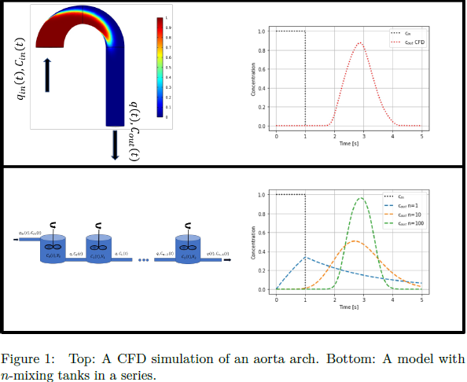
Introduction
Challenges with CFD
Goal: Build a reduced-order model
Tracer injection
Notes:
Let’s look at the Computational Fluid Dynamics:
The CFD method can simulate blood flow in incredible detail, but is computationally expensive (alas, it can be very slow)
The Core idea of this project is:
Can we describe the transport of a tracer through the aortic arch using simple ODE models rather than complex 3D CFD simulations?
Tracer method
By injecting a known tracer concentration and observing the outlet, we can estimate parameters like effective volume, mixing characteristic and residence time of the blood in the arch
Instead of tracking millions of fluid elements, we solve a handful of ODEs
But how close can this simple model come to the CFD?

Slide 4
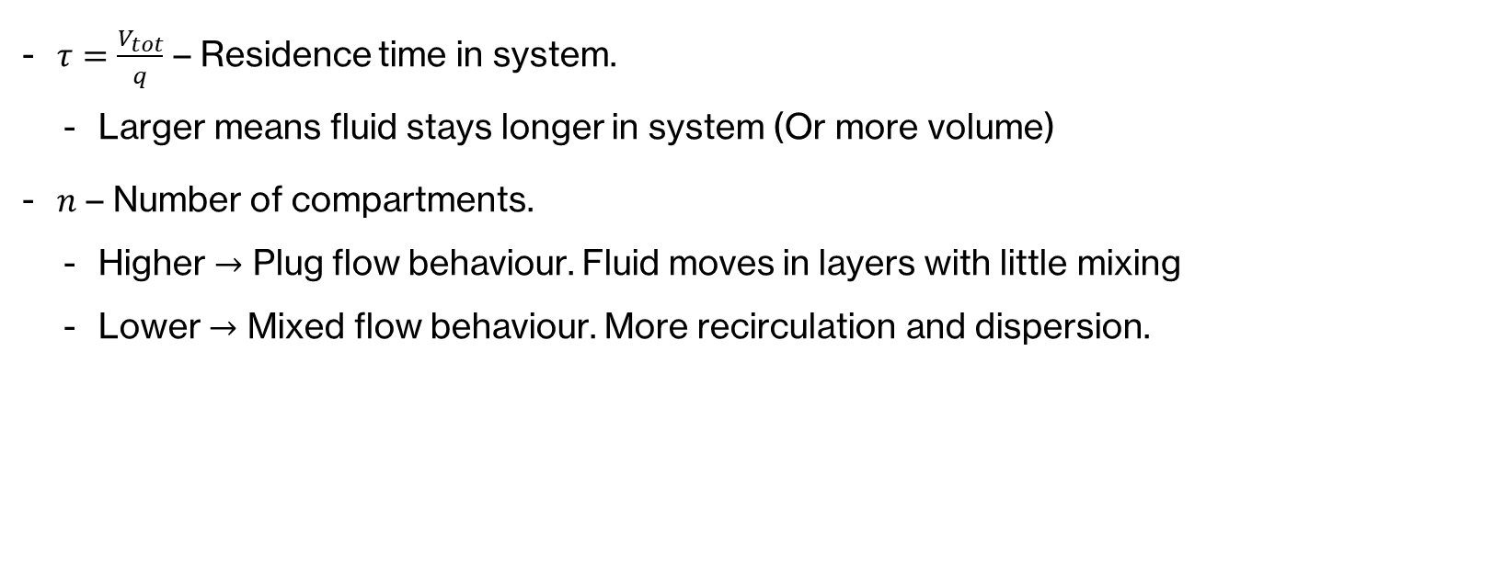
Parameter interpretation
$τ=\frac{V_{tot}}{q}$ – Residence time in system.
  Larger means fluid stays longer in system (Or more volume)
$n$ – Number of compartments.
  Higher $→$ Plug flow behaviour. Fluid moves in layers with little mixing
  Lower $→$ Mixed flow behaviour. More recirculation and dispersion.

Slide 5


Governing Theory
n-CSTR model
  n = number of compartments
  $tau=\frac{V_{tot}}{q}$
    q = flow rate
Notes:
Each tank represents a small perfectly mixed volume of blood.
The tracer moves sequentially through these tanks
Increasing the number of tanks “n” makes the system behave more like plug flow
Plug flow: No back-mixing, constant velocity across the cross-section
Decreasing number of tanks “n” makes the system more mixed and diffusive
Key parameters are number of tanks “n” and total residence time “tau”

Slide 6
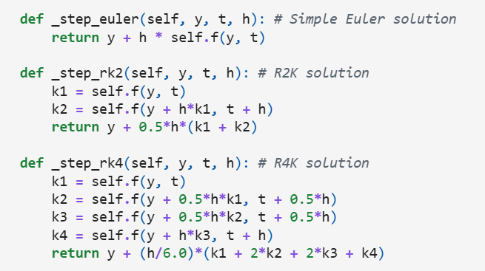


Numerical Implementation
ODE form
Euler, RK2, RK4
Notes:
To simulate this system, we implemented our own numerical ODE solvers
Euler, RK2 and RK4
Each method estimates how the tracer concentration evolves through the tanks over time, using different levels of accuracy and computational cost
The code snippet shows how the solver is called
The ODESolver class handles all three methods by specifying method
We want stable, accurate integrations before comparing our results to the CFD

Slide 7
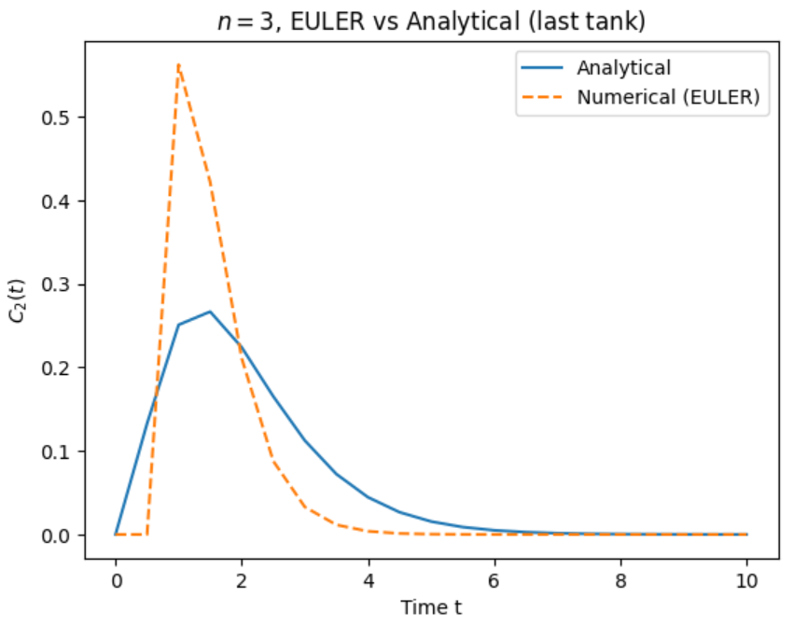
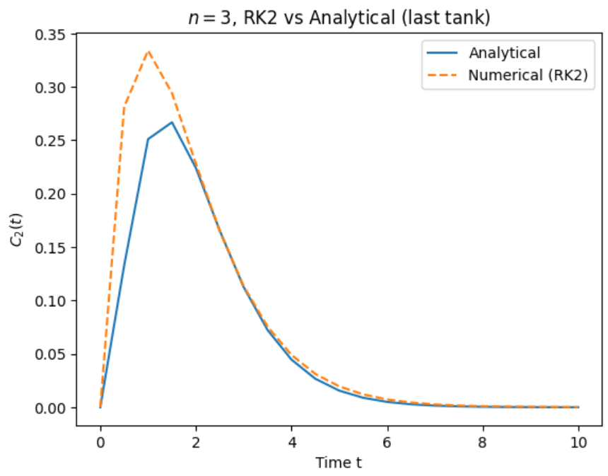
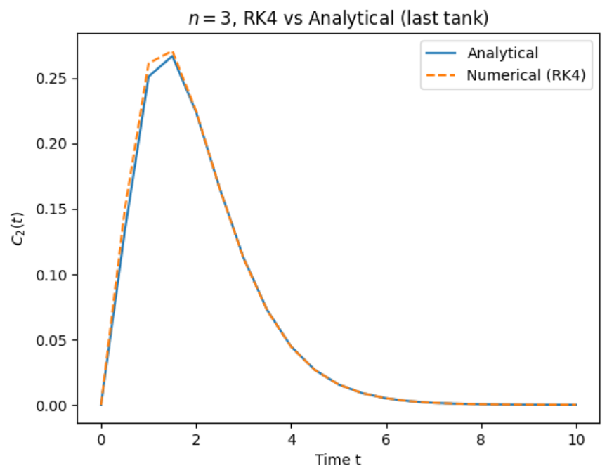
Numerical Implementation
Analytical vs Numerical Solution
Notes:
Before using our solvers on real data, we validated the solvers against known analytical solutions for n=1,2 and 3
The plots show the analytical solution in black, and the numerical in color
What we expect to see (for the analytical solution)
For n=1 we see an exponential decay
For n=2 and n = 3we see a peak before decline
For the numerical solutions we see that
Euler show some diffusion, RK2 improves it ant RK4 almost perfectly overlaps with the analytical curve
We used a low step size “h” to more clearly show solver differences
This confirms that our solver implementation is works and RK4 is indeed the most accurate

Slide 8
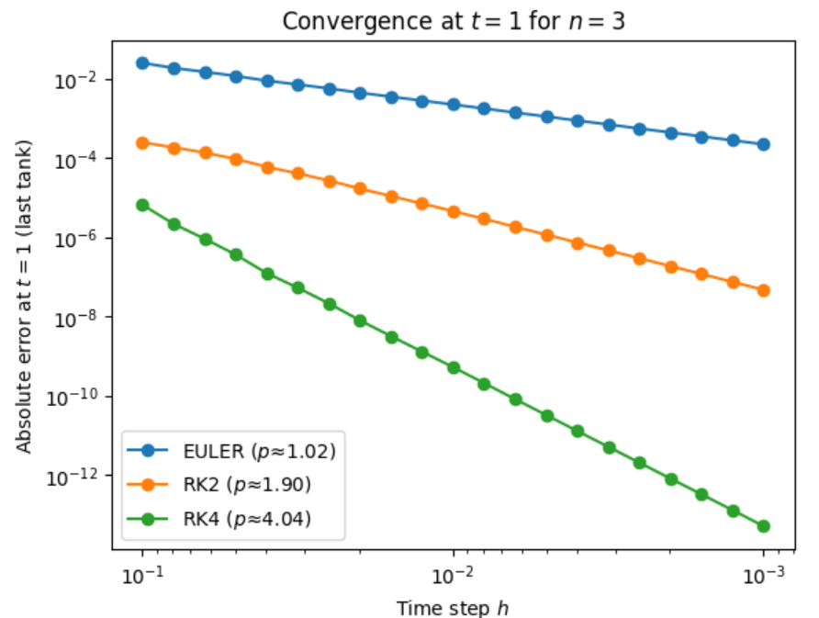
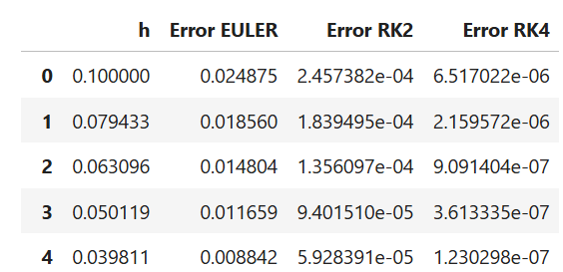
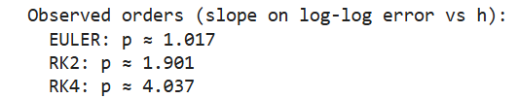
Convergence study
Log-log error plot for t = 1 (n=3)
Table of observed errors
Notes:
We then ran a convergence test to verify theoretical order of accuracy
The log-log plot shows how the absolute error decreases with smaller steps (h)
As expected,
Euler converges linearly (1st order)
RK2 converges quadratically (2nd order)
RK4 converges with 4th order accuracy
This confirms theoretical scaling and that the solvers are implemented correctly
The table of observed errors showed us the effect of step size h
This is just an extract. We tested for h =0.1 -> 0.001. Numerical errors scale as expected and we see that:
For Euler:
By halving h, error is halved
For RK2:
By halving h, error is reduced 4x
For RK4:
By halving h, error is reduced by 16x

Slide 9

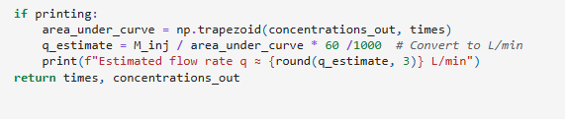
CFD Data and Cardiac Output
Stewart-Hamilton equation
Result: q = 5L/min
Notes:
From the known inlet tracer mass and outlet concentration curve, we estimate the cardiac output using Stewart-Hamilton principle. Finding the denominator by taking the area under the concentration and times.

Slide 10
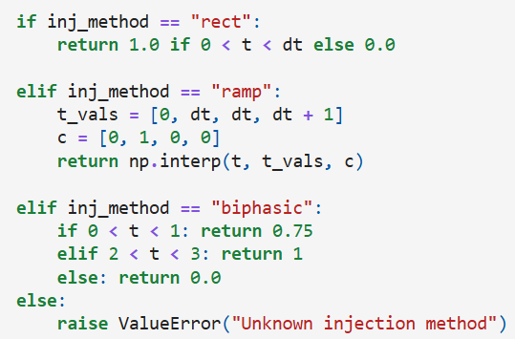
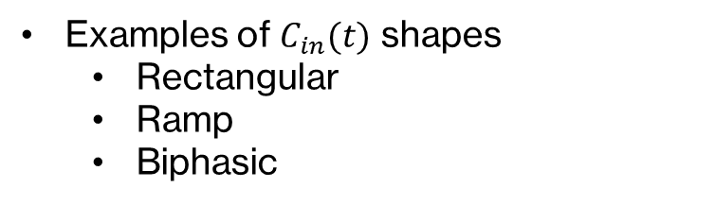
Injection Protocols & Model Setup
Examples of $C_{in}(t)$ shapes
  Rectangular
  Ramp
  Biphasic
Notes:
We created a general function for the different injection methods, and then creating the specific cases, where one can put in a t and get the concentration of the injection flow.

Slide 11
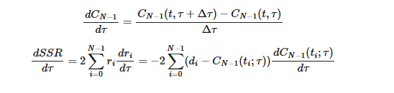

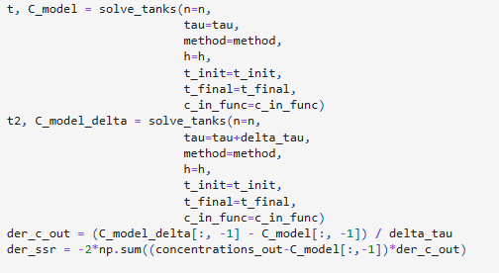
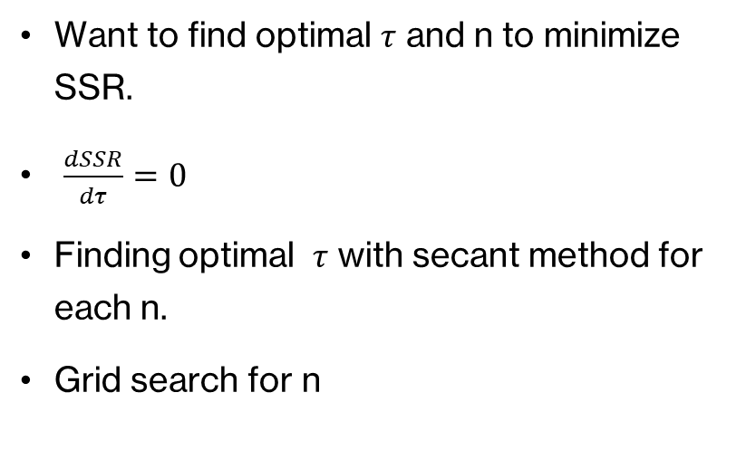
Fitting the Healthy Aorta Data
Want to find optimal $τ$ and n to minimize SSR.
$\frac{dSSR}{dτ}=0$
Finding optimal $τ$ with secant method for each n.
Grid search for n
Notes:
We want to find the optimal tau and n to minimize SSR of the model to the data. To find the optimal tau and number of compartments we are first creating a function that finds the optimal tau, i.e. when the derivative over tau is zero, using secant method
Comment on the functions. F in the tau formula is the derivative of SSR.

Slide 12
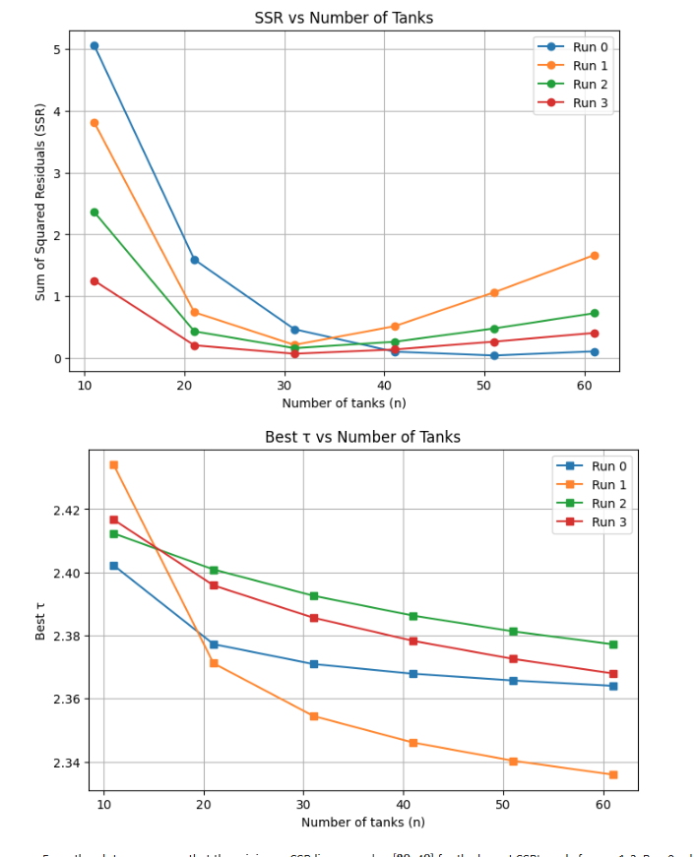
Fitting the Healthy Aorta Data
Results
  n = 49
  Tau = 2.36
Notes:
We first plot each 10 n interval, solving for each of the methods (retrieving the data from each csv file, looking at how a more general solution might look like)
Best fit was found at n = 49, tau = 2.36, meaning the modelling of the flow behaves nearly like plug flow
The model reproduces the outlet concentration with very good accuracy, and low SSR
One can see from the graph that we will expect a high SSR for run 1 which is the biphasic phase. If one had used lower n, the SSR would be lower for the other cases, and higher for rect_1s.

Slide 13
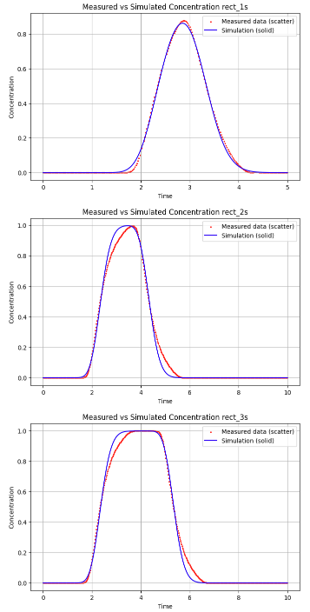
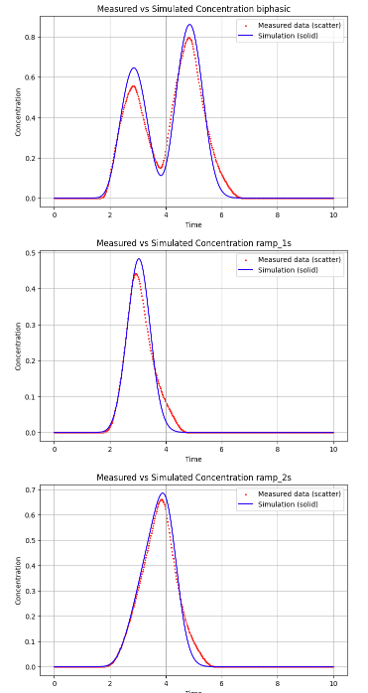
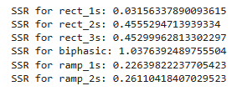
Results
Overall good match
Biphasic highest SSR
Notes:
SSR is lowest for the training case, as expected, but stays low for other cases too, meaning the model works well without re-fitting. Biphasic has the highest SSR. From the plot earlier this is expected. The best fit for the biphasic case was with a lower number of compartments, which means that the complex nature of the injection protocol is not captured as nicely by assuming less mixing in the tank.
We can also see that the ramp SSRs are lower than the rect, which might be because of their smooth nature (No drastic changes), and therefore being captured better by the model and the higher n.

Slide 14
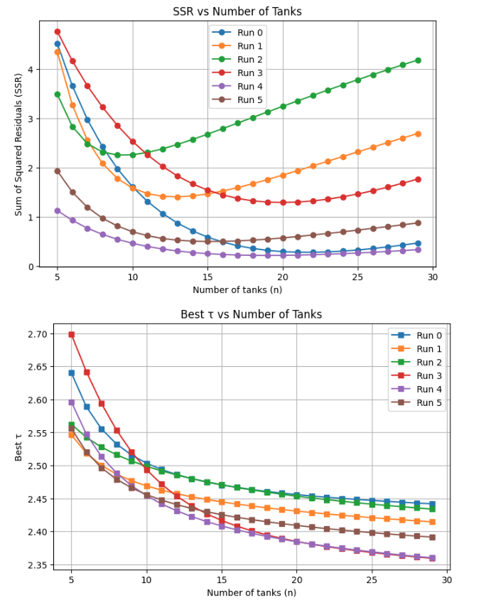
Aneurysm Case
Results
  n = 21
  Tau = 2.45
Notes:
Doing the same recipe for the aneurysm case and seeing a larger deviation and higher SSR in general for the different fits. We are also seeing that the models are optimizing with less number of compartments.

Slide 15
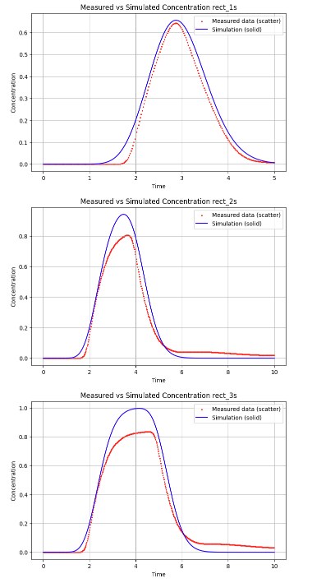
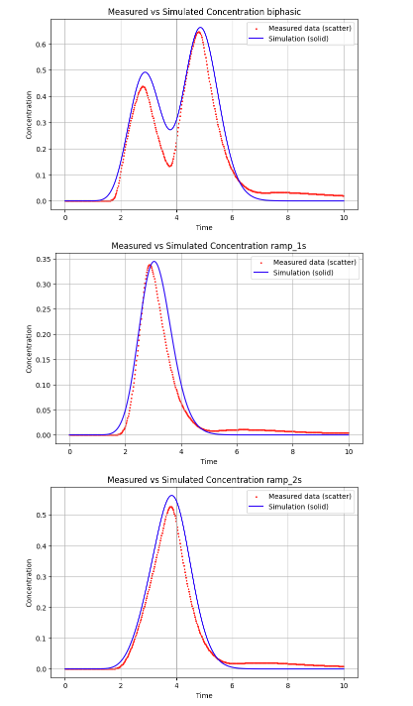
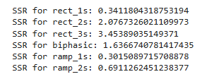
Results
Worse fit
  Higher SSRs
Notes:
The model fits healthy cases better than aneurysm cases because it assumes equal compartment volumes and smooth flow—conditions that fail with aneurysms. Ramp injections give lower SSR than rectangular ones since the model handles gradual changes better than sudden jumps.
Aneurysm cases needed far fewer compartments (n = 21) than healthy ones (n = 49), showing more dispersion and recirculation. Residence time was slightly higher, consistent with larger volume and slower washout. Higher SSR confirms the model struggles with complex aneurysmal flow.

Slide 16
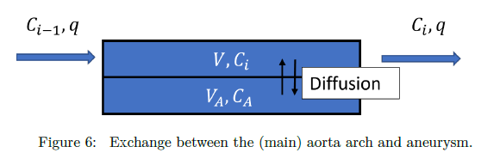
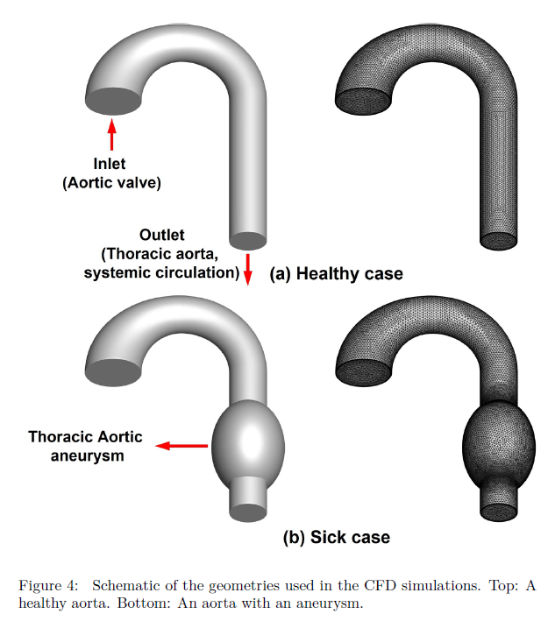

Extended Model
Added equation $V_{A}=\frac{dC_{A}}{dt}=D(C_{i}−C_{A})$
Results
  D = 0.9
  VA = 5.0
  SSR improvement: 0.34 -> 0.18
  Diagram: Main flow + side aneurysm pocket
Notes:
To improve the fit further, we extend the model by adding a side reservoir to represent the aneurysm pocket
The new equation describes exchange between the main flow and the side volume
We optimized parameters and found D = 0.8 (exchange rate constant) and VA = 5.0 (reservoir volume) giving a better SSR of 0.18, and improvement factor of about 1.85 compared to aneurysm case without side reservoir
Physically, this means that the aneurysm acts as a large, slow exchanging reservoir near the outlet rather than just a part of the main flow path
This captures the delayed washout in the CFD data

Slide 17
Discussion
Strengths
  Simple & fast, ideal for diagnostics
  Physically interpretable results
  Good generalization to new inputs
Weaknesses
  Loses spatial detail
  Empirical data fitting
  Limited accuracy for complex 3D flow
Notes:
The main strength of the n-CSTR approach are its simplicity and speed
It turns CDF-scale complexity into two easy parameters (n and tau), directly reflecting the flows mixing and residence characteristics
However, its not perfect.
Each tank assumes perfect mixing (so we lose spatial detail)
Since parameters are fitted rather than measured, the model can’t capture local flow patterns or backflow accurately in complex geometries
Overall, it’s a great reduced-order model for interpreting flow systems efficiently
But not a CFD replacement when geometry-specific information is required

Slide 18
Conclusion & Learning Outcomes
Key results
  Healthy n = 49, tau = 2.36
  Aneurysm n = 21, tau = 2.45
  Extended model, SSR reduced by factor 1.85
Summary
  Solvers validated (Euler, RK2 and RK4)
  CFD matched with simple ODE model
  Reduced-order model captures physiology at low cost
Notes:
To summarize, the n-CSTR model successfully reproduced the CFD outlet with high accuracy
Through the project we have showed that
A simple reduced order n-CSTR model can capture the essential transport behavior of blood flow in an aortic arch
That the healthy aorta exhibits plug-like-flow transport with parameters n=49 and tau = 2.36
That the aneurysm aorta cause stronger dispersion and slower washout with parameters n= 21 and tau = 2.45
By extending the model with a side aneurysm volume we improve accuracy further and confirm the presence of slow recirculation zones
The project shows that simple ODE-based models can describe complex flow behavior when properly calibrated

Slide 19
Conclusion & Learning Outcomes
Learning objectives
  Implement an ODE solver using the Euler, Runge-Kutta (second and fourth order) algorithm
  Use mixing tank models to model how the shape of a medical tracer changes after traveling in an aorta arch
  Compare the ODE model to CFD simulation results and extract information about the cardiac output (flooding rate) and volume of the aortic arch
  Investigate if one can use the tracer signal to identify if there is a an aneurysm in the aorta

